Slide 1

LAPTOP DATA ANALYSIS
PYTHON REINFORCEMENT ASSESMENT
PRESENTED BY : RAAGULPRADAN D

Slide 2
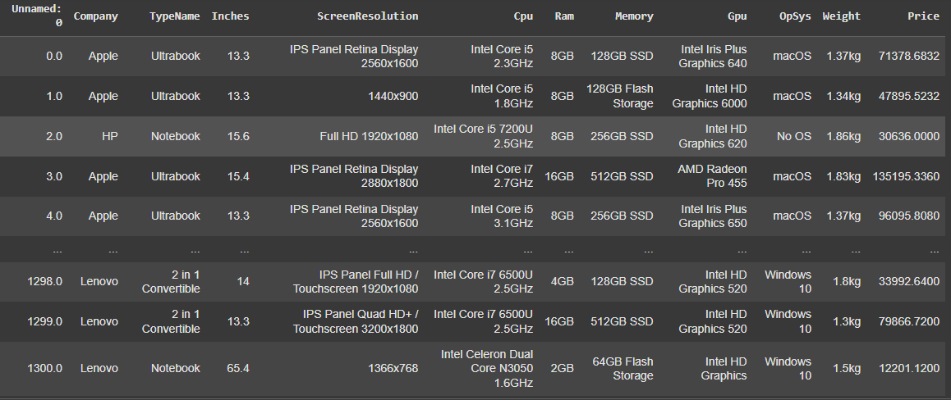
DATASET OVERVIEW

Slide 3

DATA UNDERSTANDING & CLEANING
Load the laptop.csv dataset into a Pandas DataFrame and display the first 5 rows
Split the column Memory into HDD and SSD capacity.

Slide 4
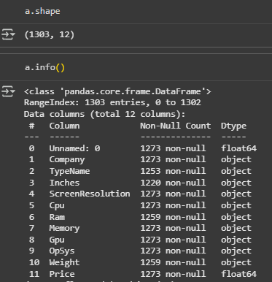
Check the shape and data types of all columns.

Slide 5
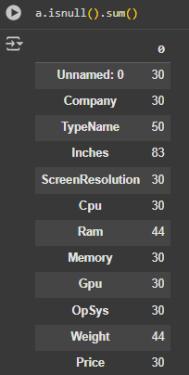

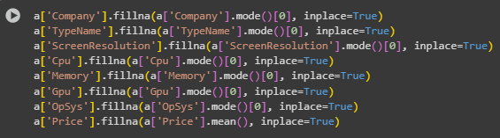
Identify and handle missing values in the dataset

Slide 6
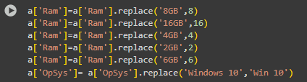
Extract the numeric value from the column Ram.

Slide 7
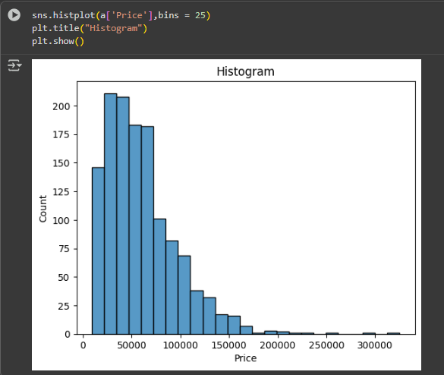
UNIVARIANT ANALYSIS

Slide 8

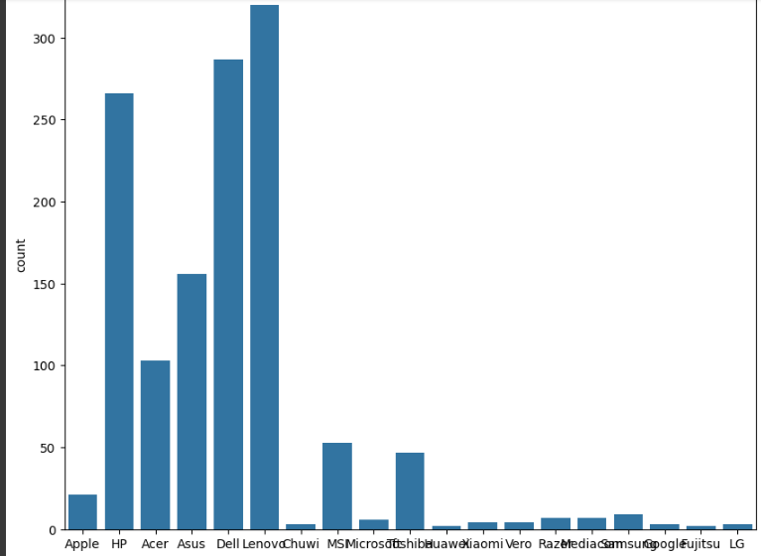

Slide 9
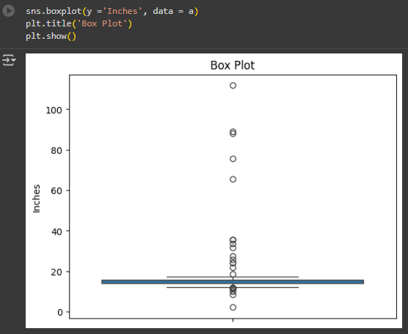

Slide 10
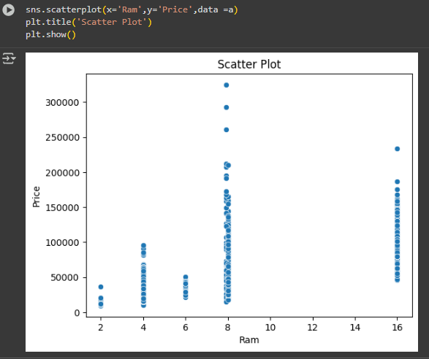
BIVARIANT ANALYSIS

Slide 11
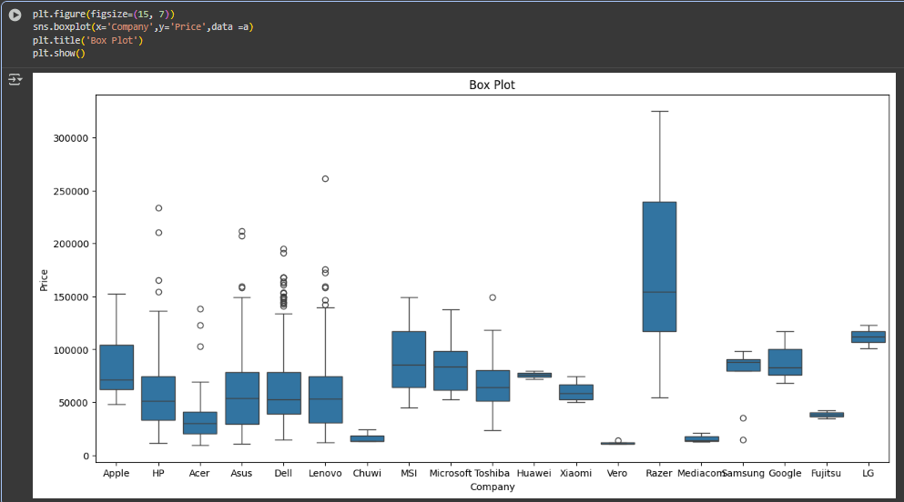

Slide 12
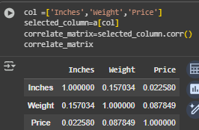
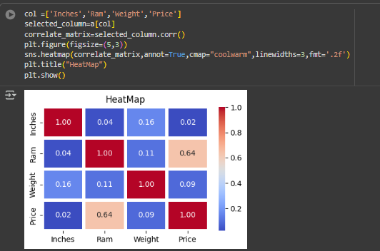
MULTIVARIANT ANALYSIS

Slide 13
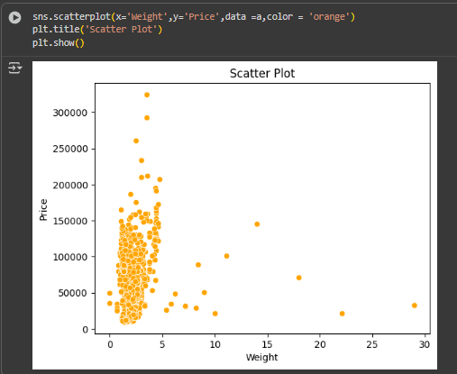

Slide 14
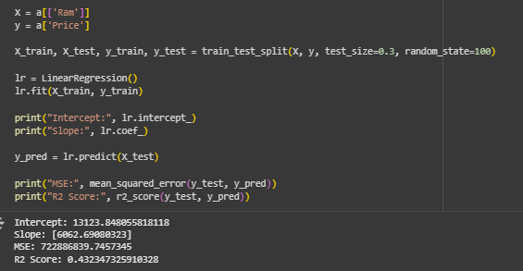
LINEAR REGRESSION

Slide 15
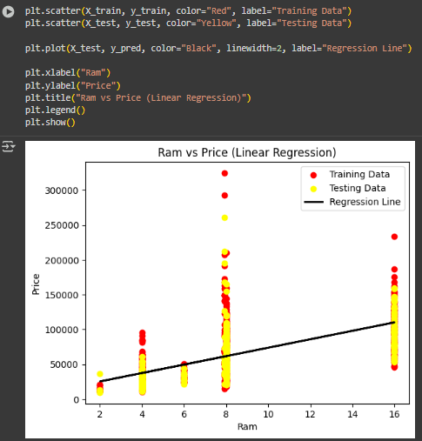

Slide 16
INSIGHTS FOR PRICING STRATEGIES
Mid-range appeal: Most laptops fall into a moderate price range (₹30,000–₹70,000), suggesting strong consumer demand there.
Brand leverage: Well-known brands (like Lenovo, Dell, HP) can price higher even with similar hardware specs due to reputation.
Spec sensitivity: Upgrades in RAM, SSD, or GPU significantly increase price, showing customers are willing to pay for performance boosts.

Slide 17
INFLUENTIAL FACTOR IN LAPTOP PRICES
Hardware Specifications (RAM, storage type, processor, graphics) affect price the most.
Company reputation comes second, as premium brands charge more.
Operating system has minimal effect compared to the other two.

Slide 18
THANK YOU

